Slide 1
Progress Report: Learning dynamics in a cellular automata model of classroom interaction
clarence Ioakim t. SY
BS4 Applied physics
Adviser: Johnrob y. Bantang
Complexity science group

Slide 2
Motivation:
Model peer-to-peer learning dynamics inside the classroom
Investigate factors affecting the dynamics:
Student aptitude level
Seating arrangement (with respect to student aptitude)
Aptitude homogeneity

Slide 3
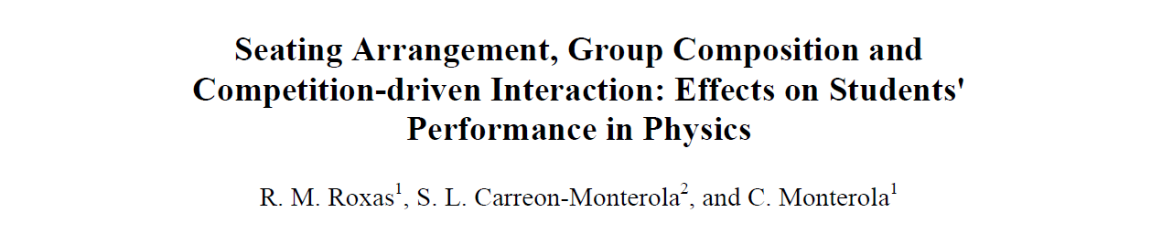
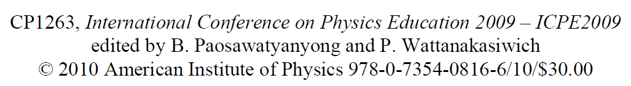
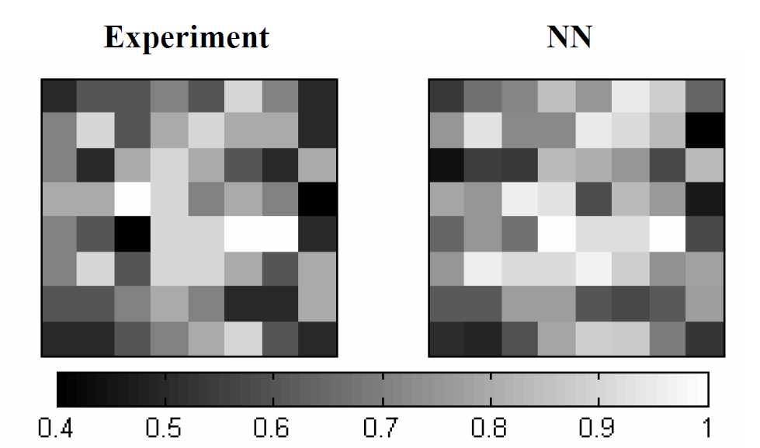
Previous study:
Main findings:
Homogeneity (locally and globally) benefits learning of the classroom
Learning is not solely dependent on how high the aptitude level of the seatmates
Notes:
Uses a neural network to predict the outcome of the classroom based on the initial seating arrangement and aptitude levels of the students

Slide 4
Research questions:
Learning rate
How does the number of learned students (binary states) or the class average (continuous states) evolve over time?
Nucleation sites position
How does the position of learned/high scoring students affect the learning rate of the class?
Homogeneity
How does the spatial aptitude homogeneity affect the learning rate of the class?
How does the social aspect affect the classroom (Watts–Strogatz model) dynamics

Slide 5
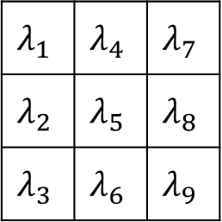

2D Binary Probabilistic CA Model
Learning probability
$$P_{i}=1−\prod_{N}{(1−S_{i}λ_{i})}$$
$$λ_{1}$$ | $$λ_{4}$$ | $$λ_{7}$$
$$λ_{2}$$ | $$λ_{5}$$ | $$λ_{8}$$
$$λ_{3}$$ | $$λ_{6}$$ | $$λ_{9}$$
Notes:
Each student belongs to a 3x3 neighborhood $N$ (Moore neighborhood) with a $λ_{i}$ chance from learning from their neighbors $n_{i}$ with state $S_{i}$
Note: student of interest is set to be the center of the neighborhood ($n_{5}$)

Slide 6
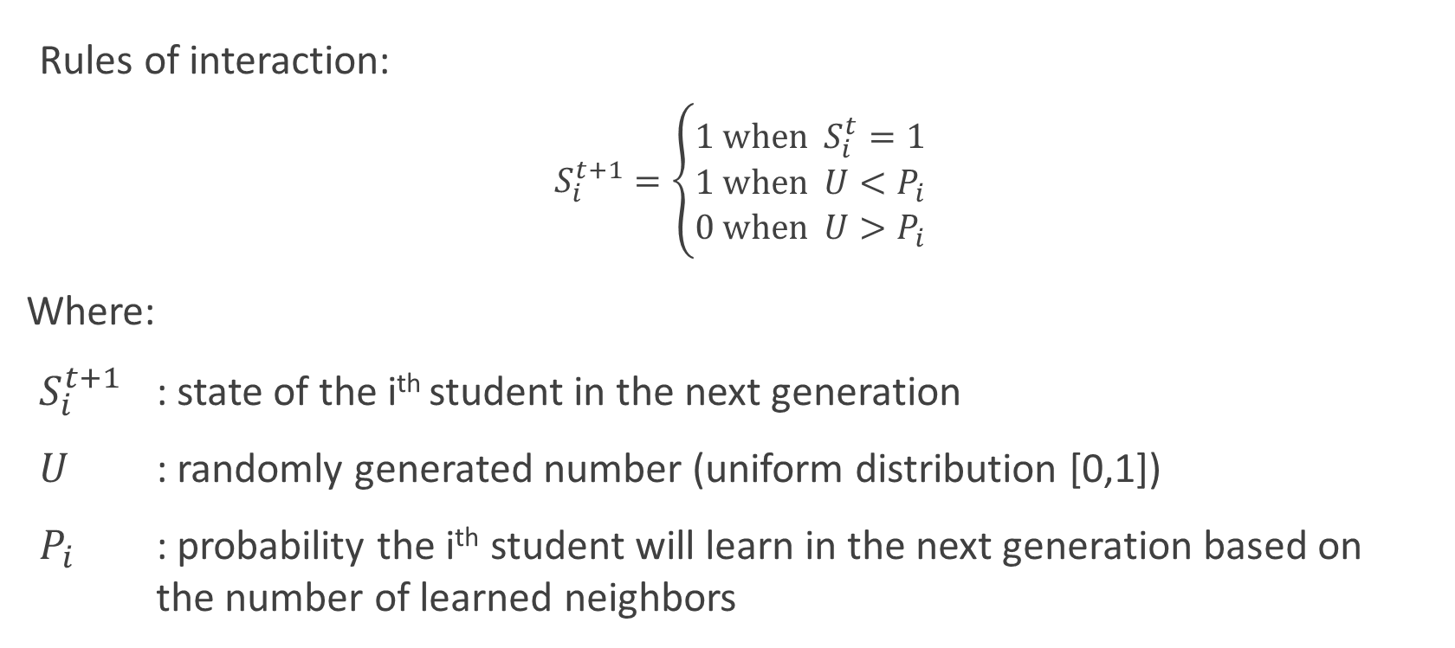
2D Binary Probabilistic CA Model
Rules of interaction:
$$S_{i}^{t+1}=\left\{\begin{aligned}1 \text{when} S_{i}^{t}=1 \\ 1 \text{when} U<P_{i} \\ 0 \text{when} U>P_{i}\end{aligned}\right.$$
Where:
$S_{i}^{t+1}$ : state of the i^{th} student in the next generation
$U$ : randomly generated number (uniform distribution [0,1])
$P_{i}$ : probability the i^{th} student will learn in the next generation based on the number of learned neighbors

Slide 7
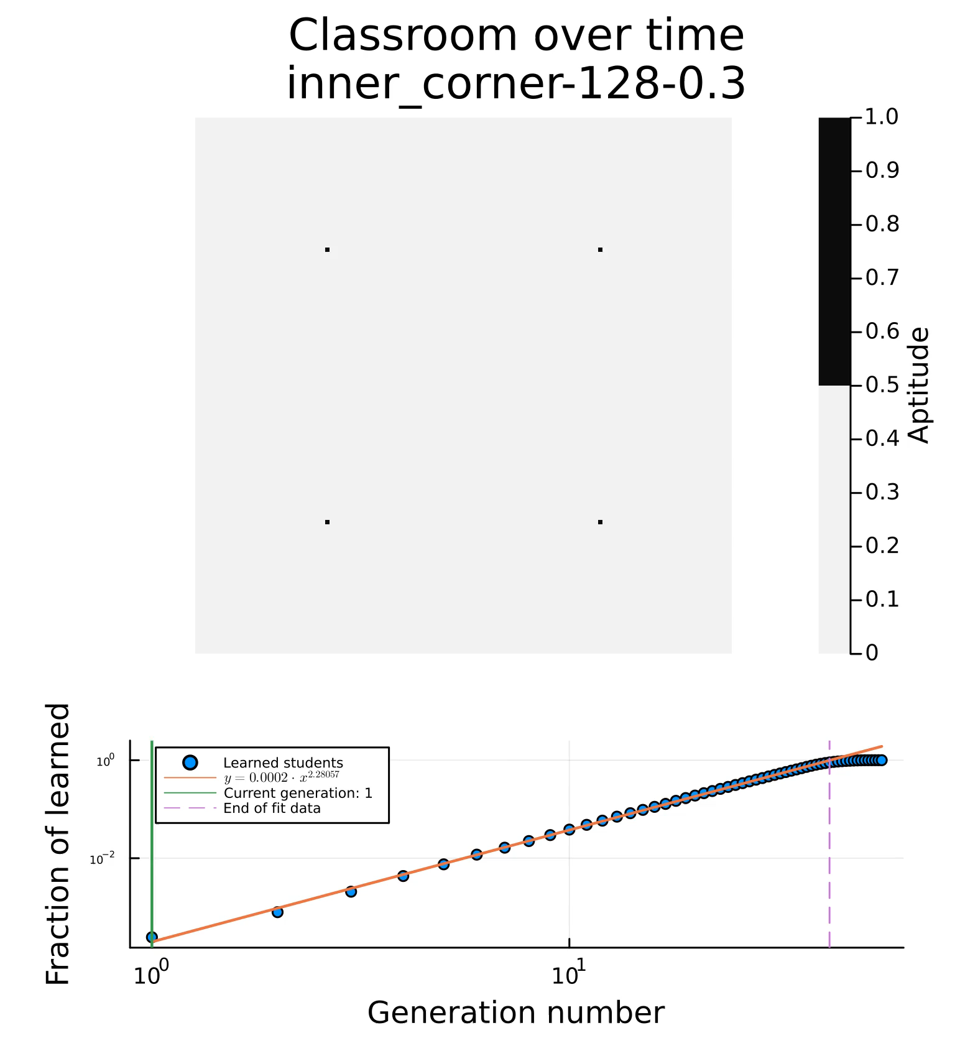
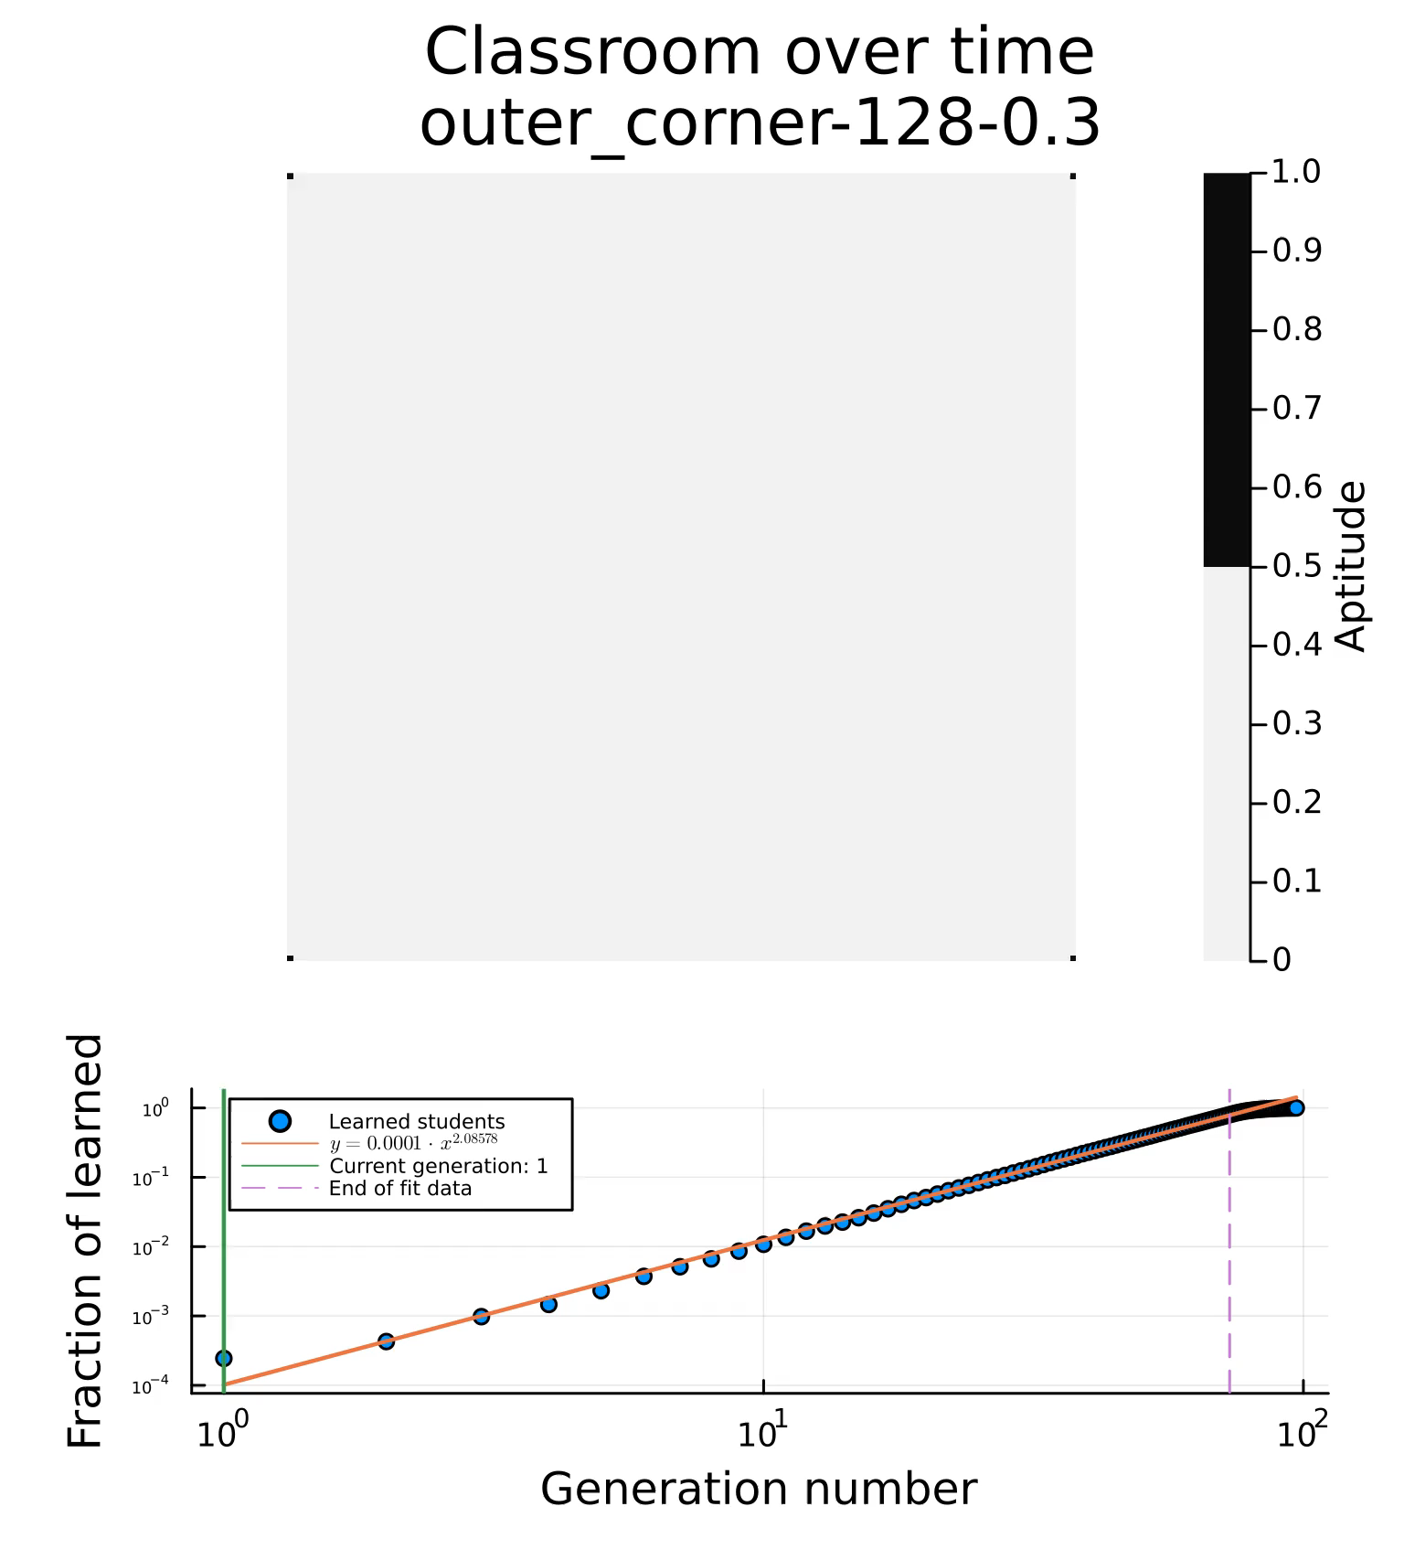
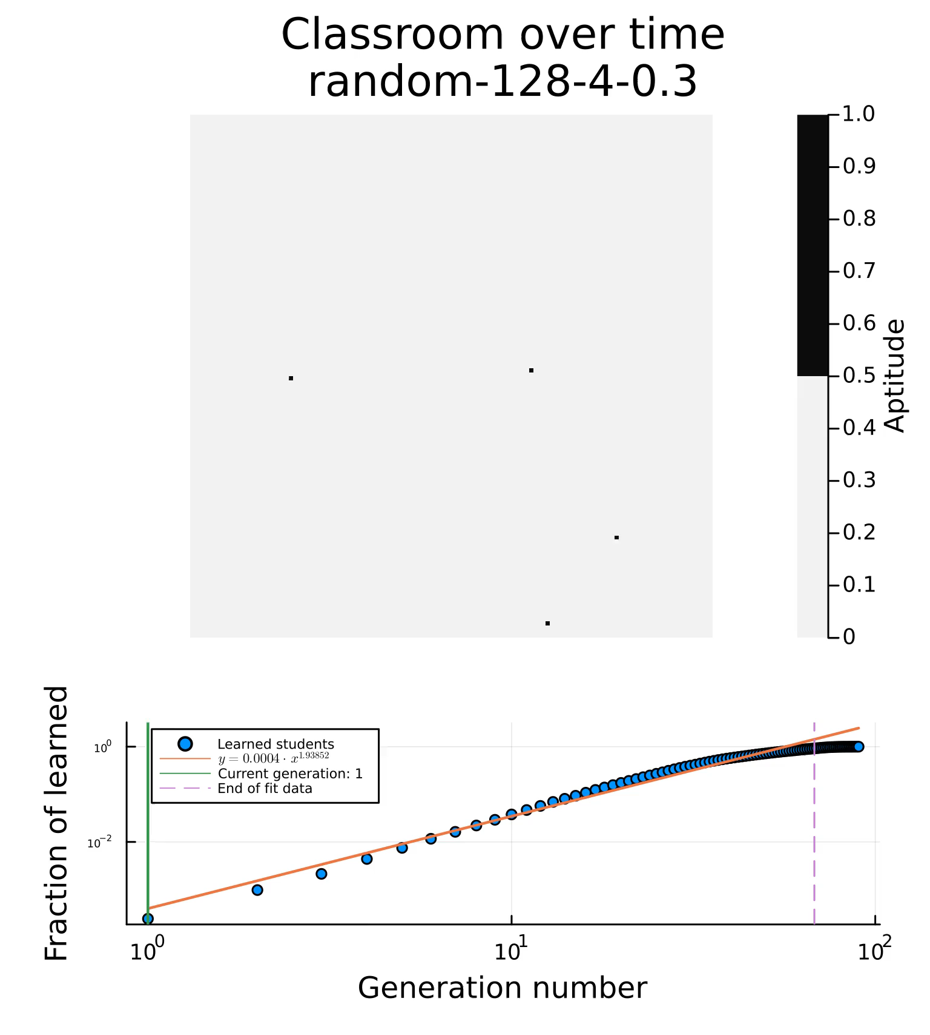
2D Binary Probabilistic Cellular Automata Model

Slide 8
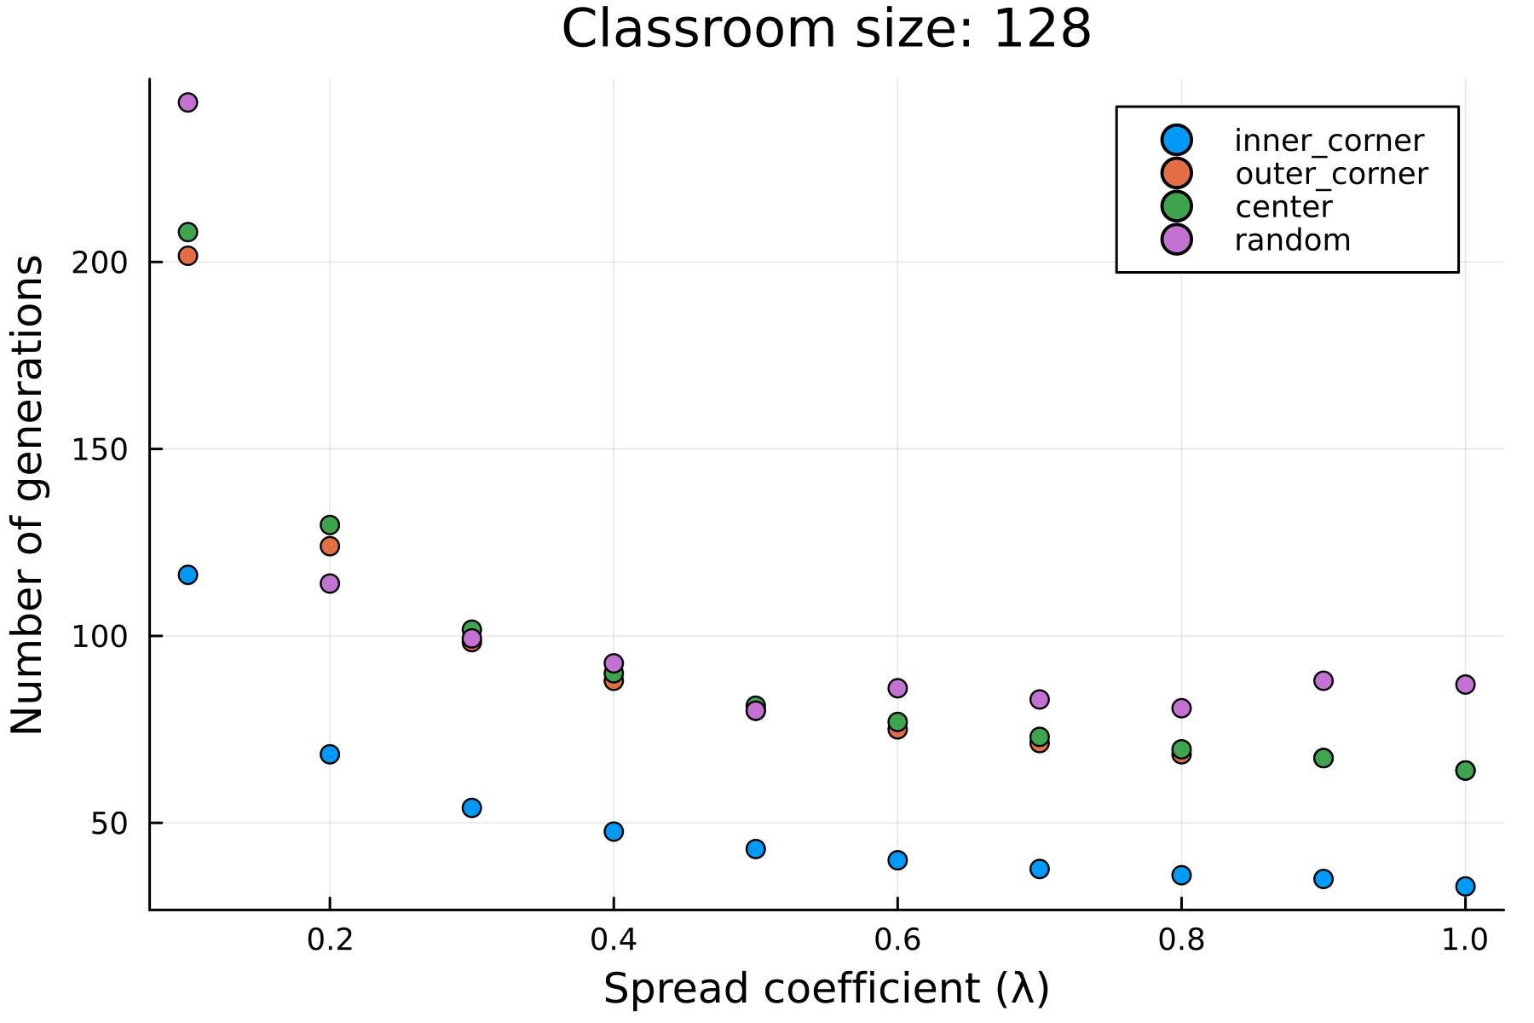
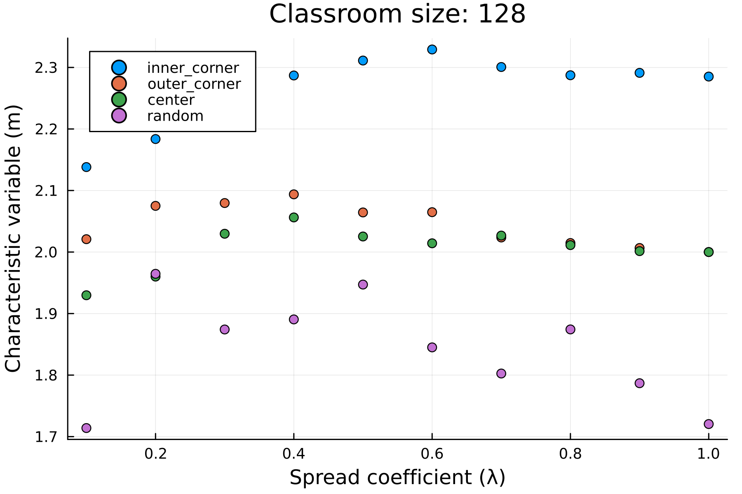

2D Binary Probabilistic Cellular Automata Model
Plots for:
Spread coefficient ($λ$) vs Characteristic variable (m)
Spread coefficient ($λ$) vs time to learn (n)

Slide 9
To do:
Introduce orientation bias in the system (anisotropic system)
Introduce inhomogeneous individual learning rate
Model the benefit of local/neighborhood homogeneity
Introduce memory or unlearning to the system
Adjust model to accommodate continuous student states
Fit model parameters to existing data

